Slide 1
Methods for Visualising Data
Learning Objectives
Construct and tailor basic data visualisations using Matplotlib & Seaborn for both numeric & non-numeric data
Meaningfully visualise aggregate data using Matplotlib and Seaborn
Expected Prior Knowledge
Experience of working with data using Data Analysis tools such as Excel.

Slide 2
Matplotlib Basics

Slide 3
Matlab Style Plotting
Matplotlib uses MATLAB style plotting
A sequence of functions “build” a graph
Base of a graph is a figure
Canvas onto which plots go
Defines the size, number of plots etc.
Added to figures are axes
One or many
Onto axes are plotted artists (i.e. plots)
Can be any style of plot, e.g. scatter, bar, pie etc.
Alterations to the graph can use OO style or MATLAB style
OO uses setters & getters
MATLAB uses series of functions
Notes:
Matplotlib is designed to mimic MATLAB plotting. In MATLAB, a sequence of function calls is used to build a figure, and this is exactly how matplotlib, and consequently seaborn, builds figures.

Slide 4
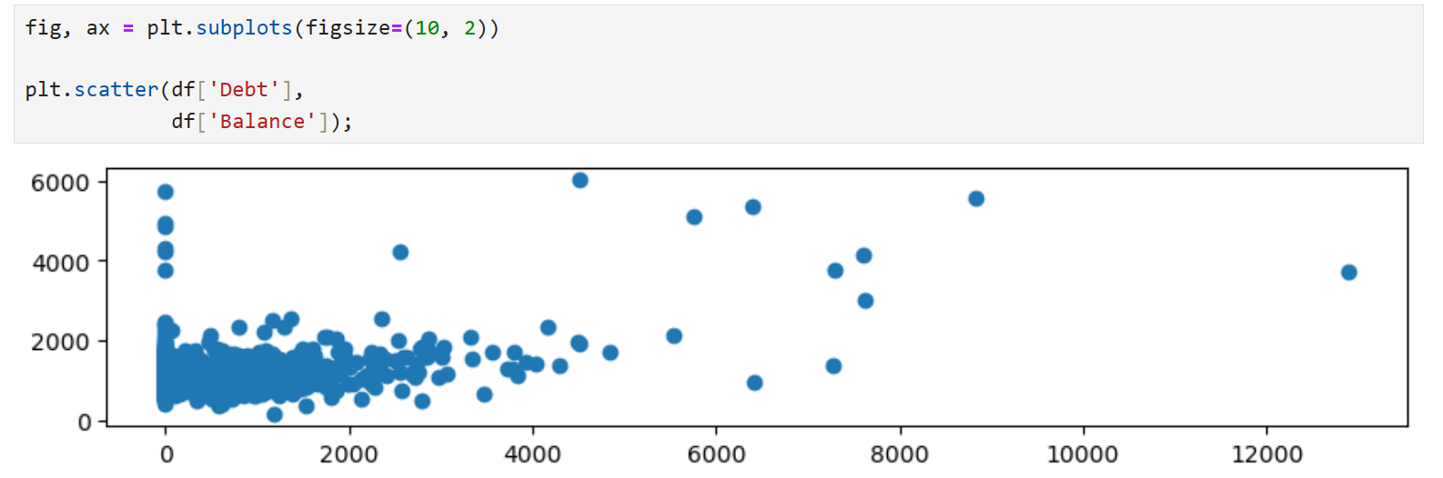
Figures & Axes, and artists
Plt.subplots creates a Figure object and an Axes object, which is part of the Figure
Plt.scatter plots data on the Axes object
Notes:
The base element in a matplotlib graphic is a figure object. These are the canvas onto which axes and glyphs are added. Figures can be created using the Figure class.
Typically, a figure will consist of a single set of axes, though it is possible to add as many as you like. The add subplots method can be used to create a grid of axes, which are defined in rows and columns.

Slide 5
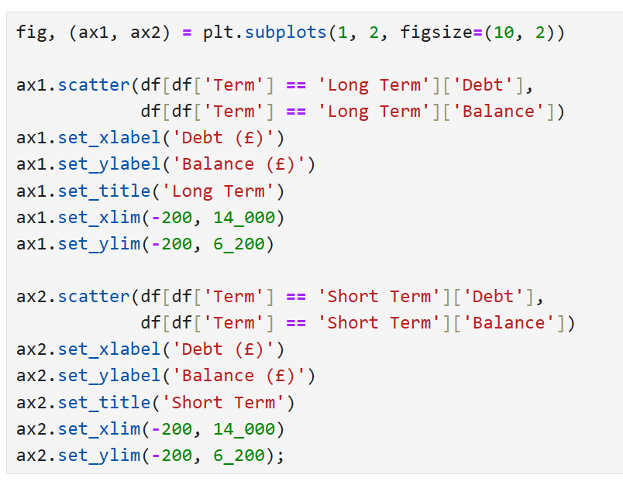
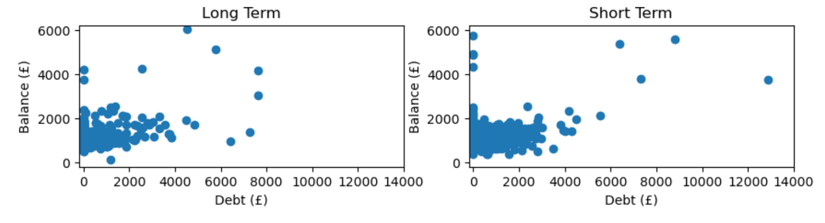
Plotting Data on Axes
Editing here is being done using the OO style
Notes:
Finally, glyphs can be added to axes by using various plotting functions.

Slide 6
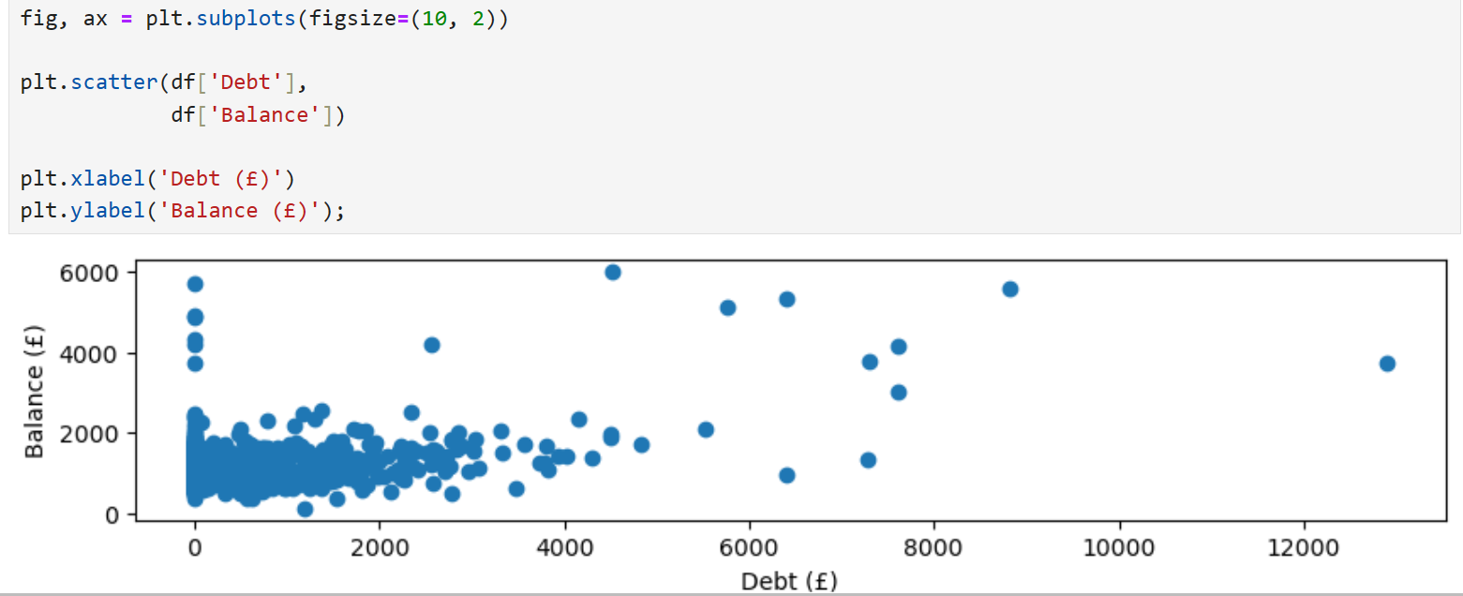
Tailoring Plots
Editing here is done using the MATLAB style
Notes:
Figures and axes can be tailored by calling any of the mentioned functions, such as xlabel or ylabel.

Slide 7
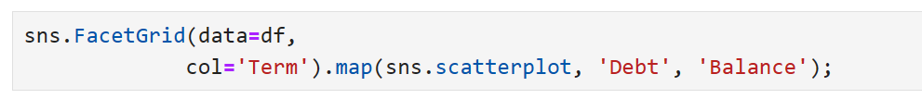
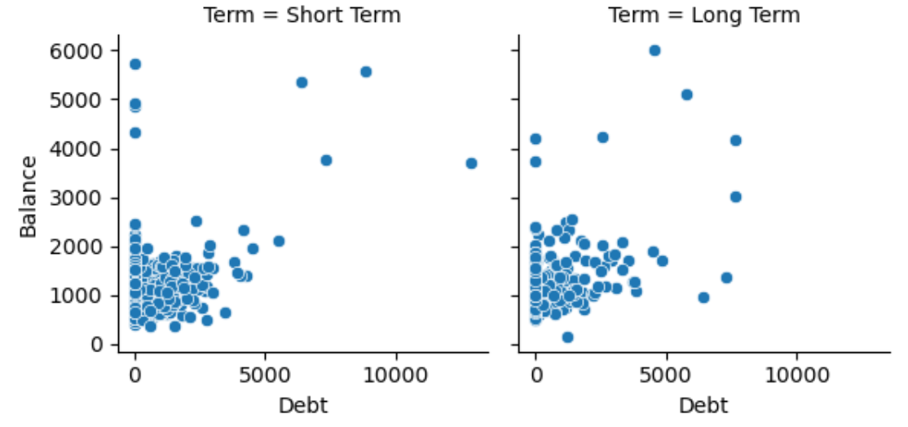
Seaborn
Seaborn makes plotting easier
It is still matplotlib under the hood
Notes:
Seaborn is a matplotlib wrapper, meaning it provides access to matplotlib via a simplified interface. We use this to produce nicer plots more quickly from dataframes.

Slide 8
Univariate Plots

Slide 9
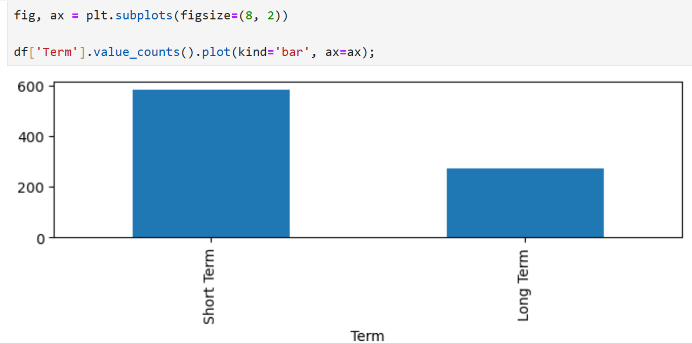
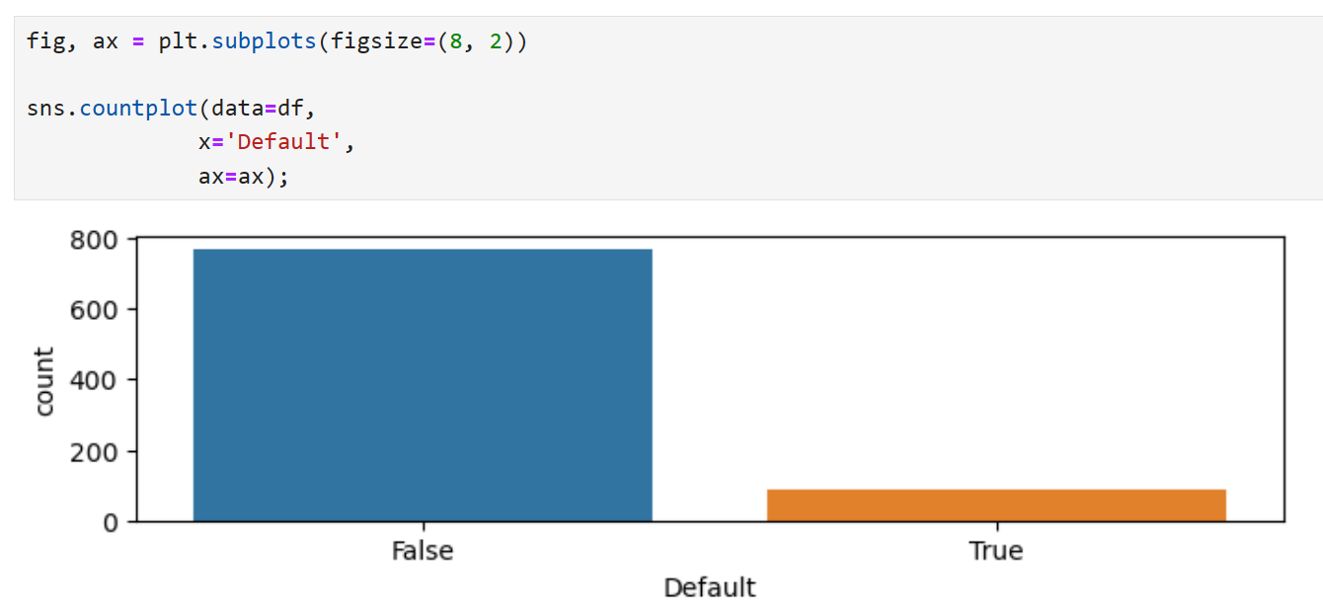
Bar Charts
Notes:
Bar charts are great for plotting categorical data. We can use value counts in conjunction with the bar plot function to aggregate data to be plotted, and normalize so plotting can be done against a common scale.

Slide 10
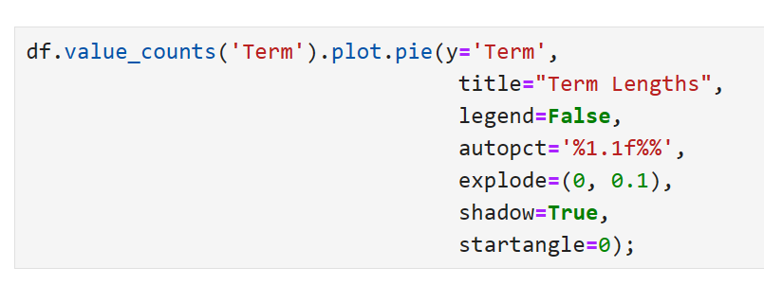
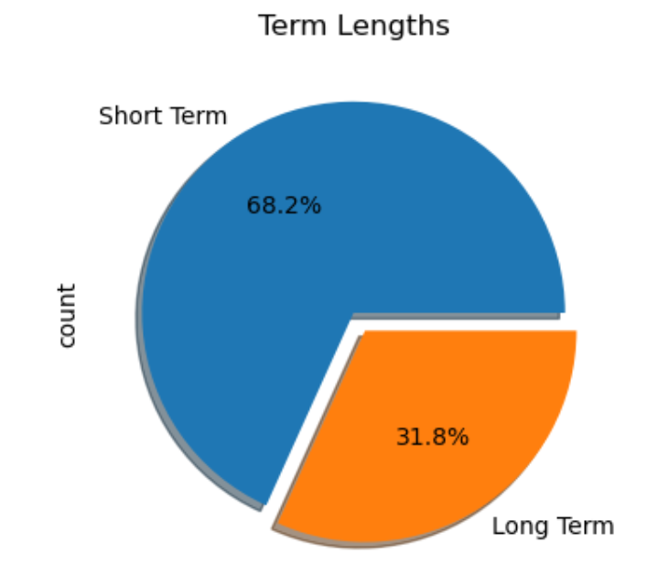
Pie Charts
Notes:
Okay for plotting simple proportions

Slide 11
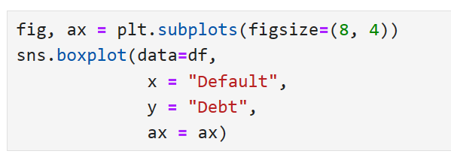
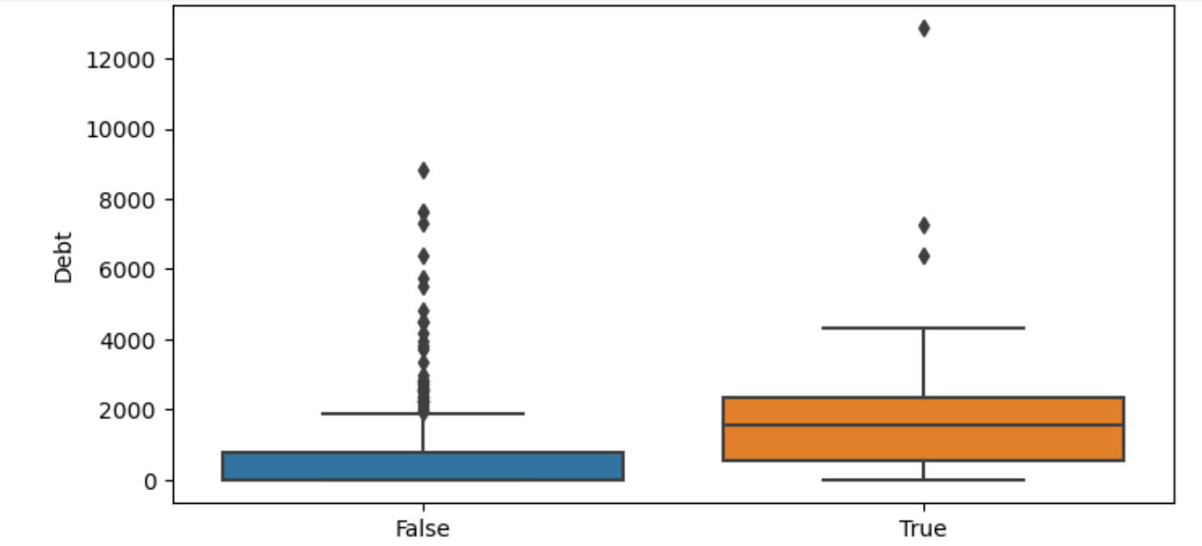
Box and Whisker Plots
Notes:
Great for plotting distributions

Slide 12
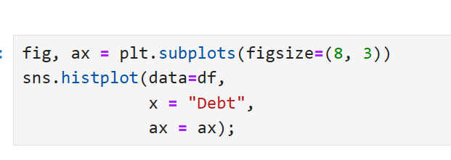
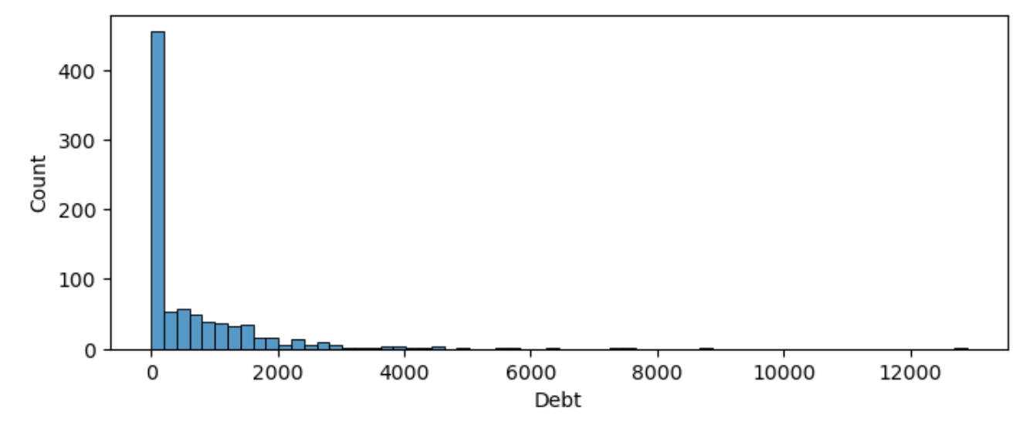
Histograms
Notes:
Great for plotting distributions

Slide 13
Bivariate Plots

Slide 14
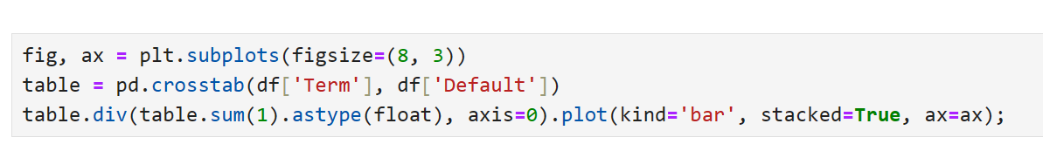
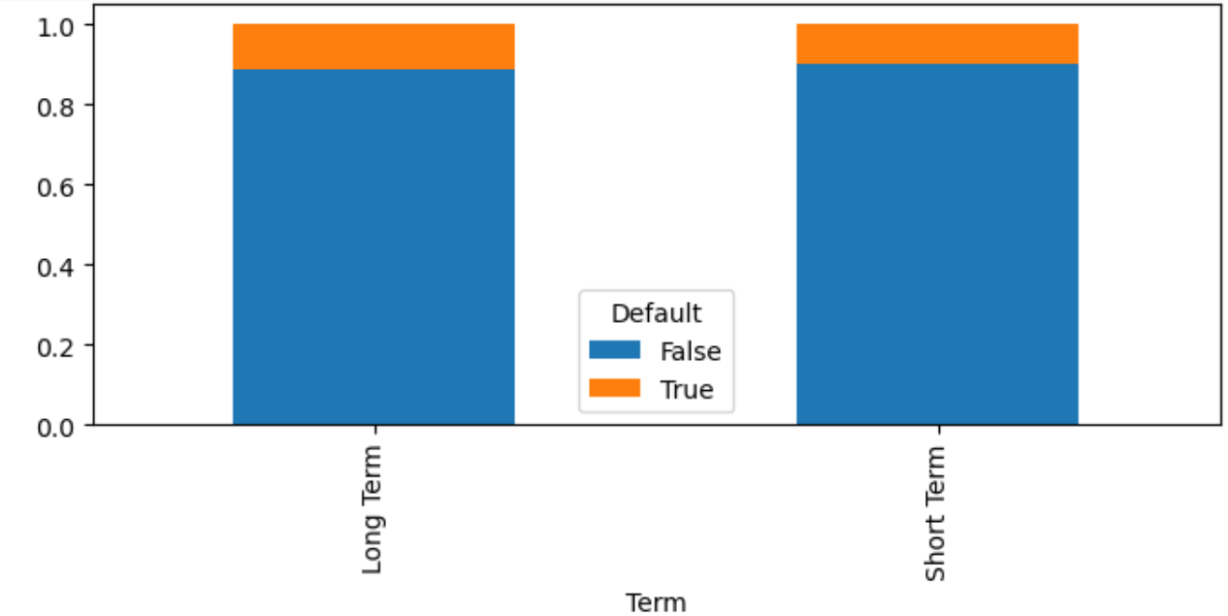
Bar Charts

Slide 15
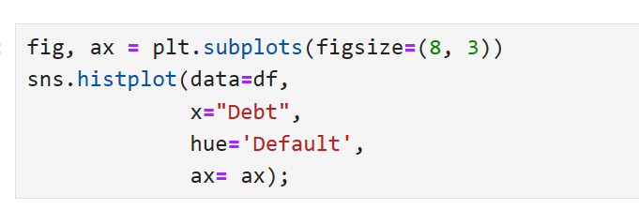
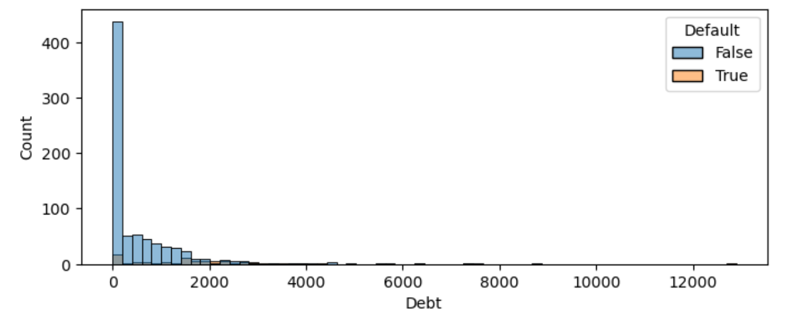
Histograms

Slide 16
Scatterplots

Slide 17
Seaborn – Making Plotting Easier

Slide 18
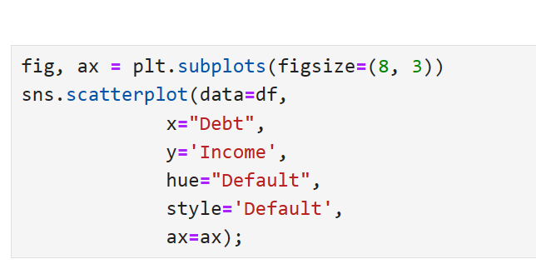
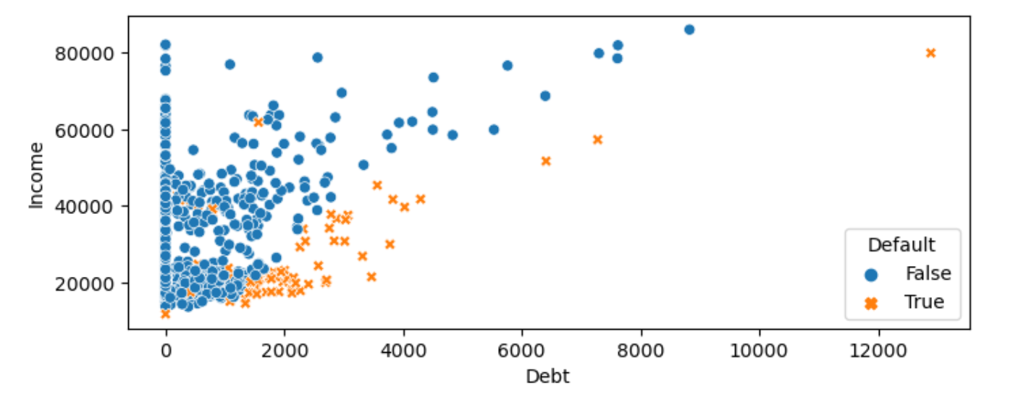
Scatterplots

Slide 19
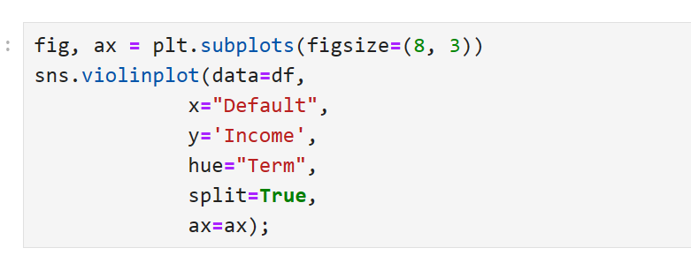
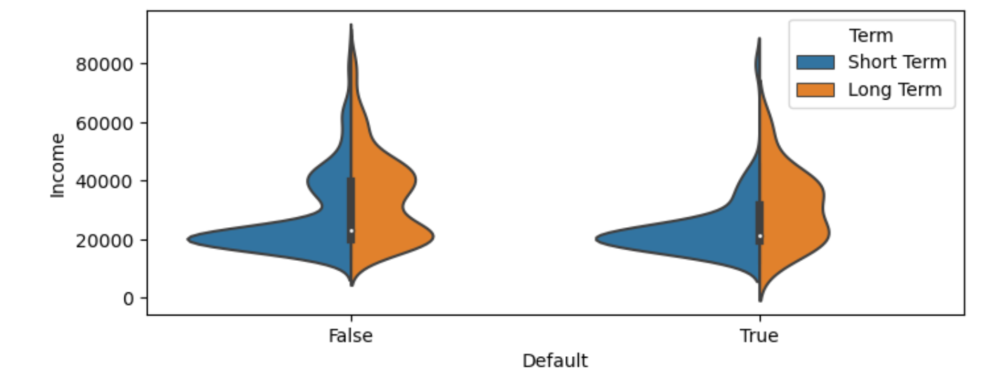
Violin Plots

Slide 20
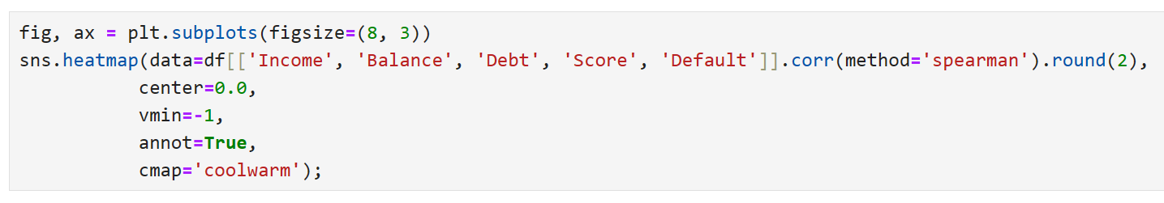
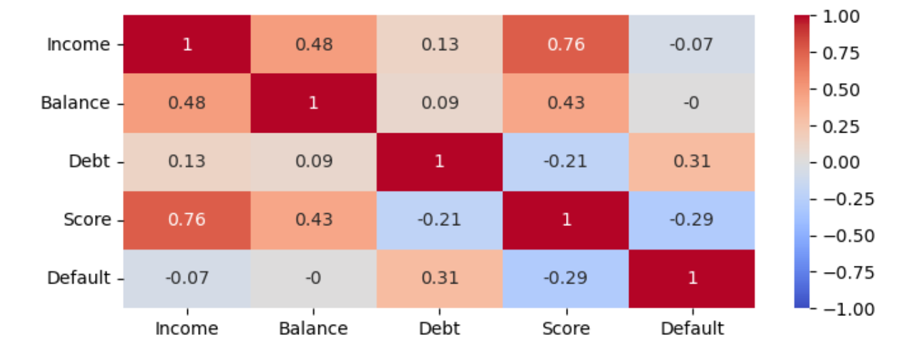
Heatmaps

Slide 21
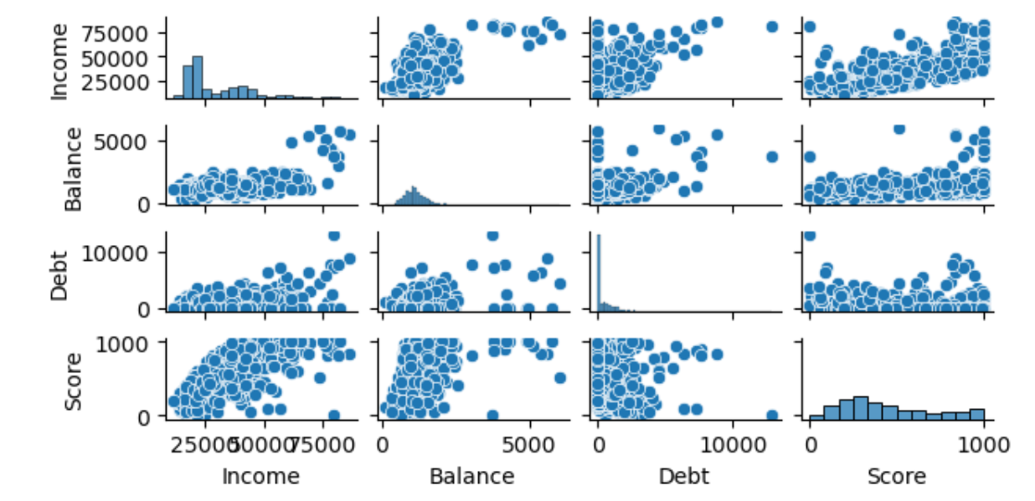
Pairplots

Slide 22
08_Methods_for_Visualising_Data_Exercise.docx
Exercise

Slide 23
Learning check
Think about your answers to these questions
What visualisations can we use to understand non-numeric data?
What visualisations can we use to understand numeric data?
What is the difference between Matplotlib and Seaborn?

Slide 24
How did you get on?
Learning Objectives
Construct and tailor basic data visualisations using Matplotlib & Seaborn for both numeric & non-numeric data
Meaningfully visualise aggregate data using Matplotlib and Seaborn

